Slide 1

CASA 101st Annual Educational & Training Seminar
May 1-4th, 2017
Saratoga Springs, NY
New York State RRT Overview
Steve Stich

Slide 2
NYS RRT Update
NYSDAM, NYSDOH, FDA
  NYSDAM (MC & AI), USDA, DEC, NYCDMHH, County DOH
Permanent NY State funded RRT Inspector position – Danielle Grady
Training
  Exercise May 31, June 1
  E-220 Traceback Investigations

Slide 3
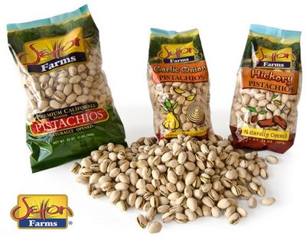
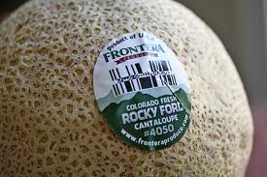
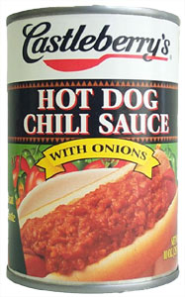

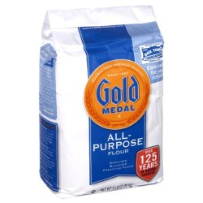
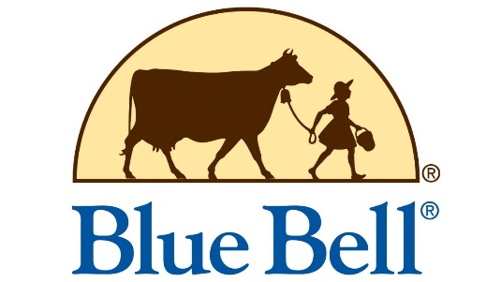
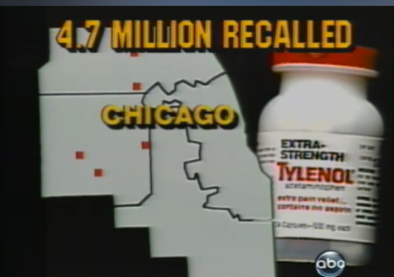
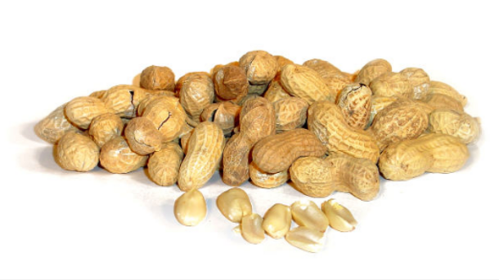
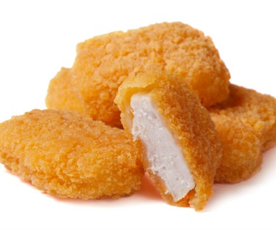

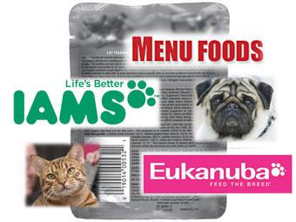
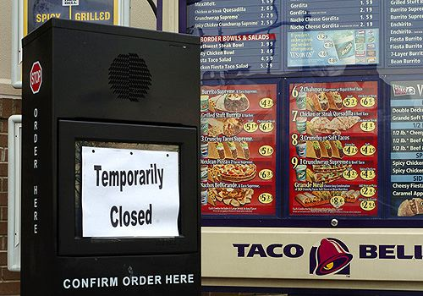

Notes:
Like a lot of other states, we’ve spent a lot of time on recalls the past few years and conducted thousands of recall effectiveness checks. We even partnered with NYC Health where we would supply them with distribution lists and store information and they would conduct effectiveness checks.
In conducting these store visits one thing became very apparent to us, we can’t visit all 25, 000 retail food stores in NY. It’s time consuming, we have limited resources and a lot of other things to do.
There’s also a large number of stores in NY that purchase their stock from club stores or cash n carries so they’re not getting the word from distributors on recalls.
I’ve brought this up at various meetings for the past year or so & the best suggestion I heard was from NC Ag: reverse 911. Send out a call to food stores in NY alerting them of food recalls. Then instead of sending out an army of inspectors we could survey the effectiveness through a few sentinels. I was really excited about it until I got home & found out what it cost. There’s no way we were going to squeeze it out of our budget. And a grant might have covered it for a couple of years, but what about after that?
Then just a few months ago we learned about a messaging system used by our State Emergency Management Office that was available for us to use. In fact some County agencies are already using it. It’s called NY Alert and the best part is it’s free for emergencies, and class 1 recalls qualify. So we’re excited again, in fact we’re planning to pilot this NYC Health and bodega in NYC.
If there are any County health departments here that want to know more about NY Alert I’d encourage you to look into it. I know Broome County’s already using it for health clinics and other notifications.

Slide 4
Multi-Agency Recall Audit Checks
Workgroup
NYSDAM, FDA, NYSDOH, NYCDOH, CEHD (Allegheny, Cattaraugus, Oneida, Suffolk, Wyoming)

Slide 5
Multi-Agency Recall Audit Checks
Notification – requesting agency
Work planning
  Division of work
  Visit or phone call? and how is it done
  Reporting work
    What form? FD 3177, or other?
  Report collection
Messaging

Slide 6
Multi-Agency Recall Audit Checks
Next Steps
Creation of Standard Operating Guidelines
Training – SOGs, Existing auditing procedures
  How to deliver
  Who to train

Slide 7
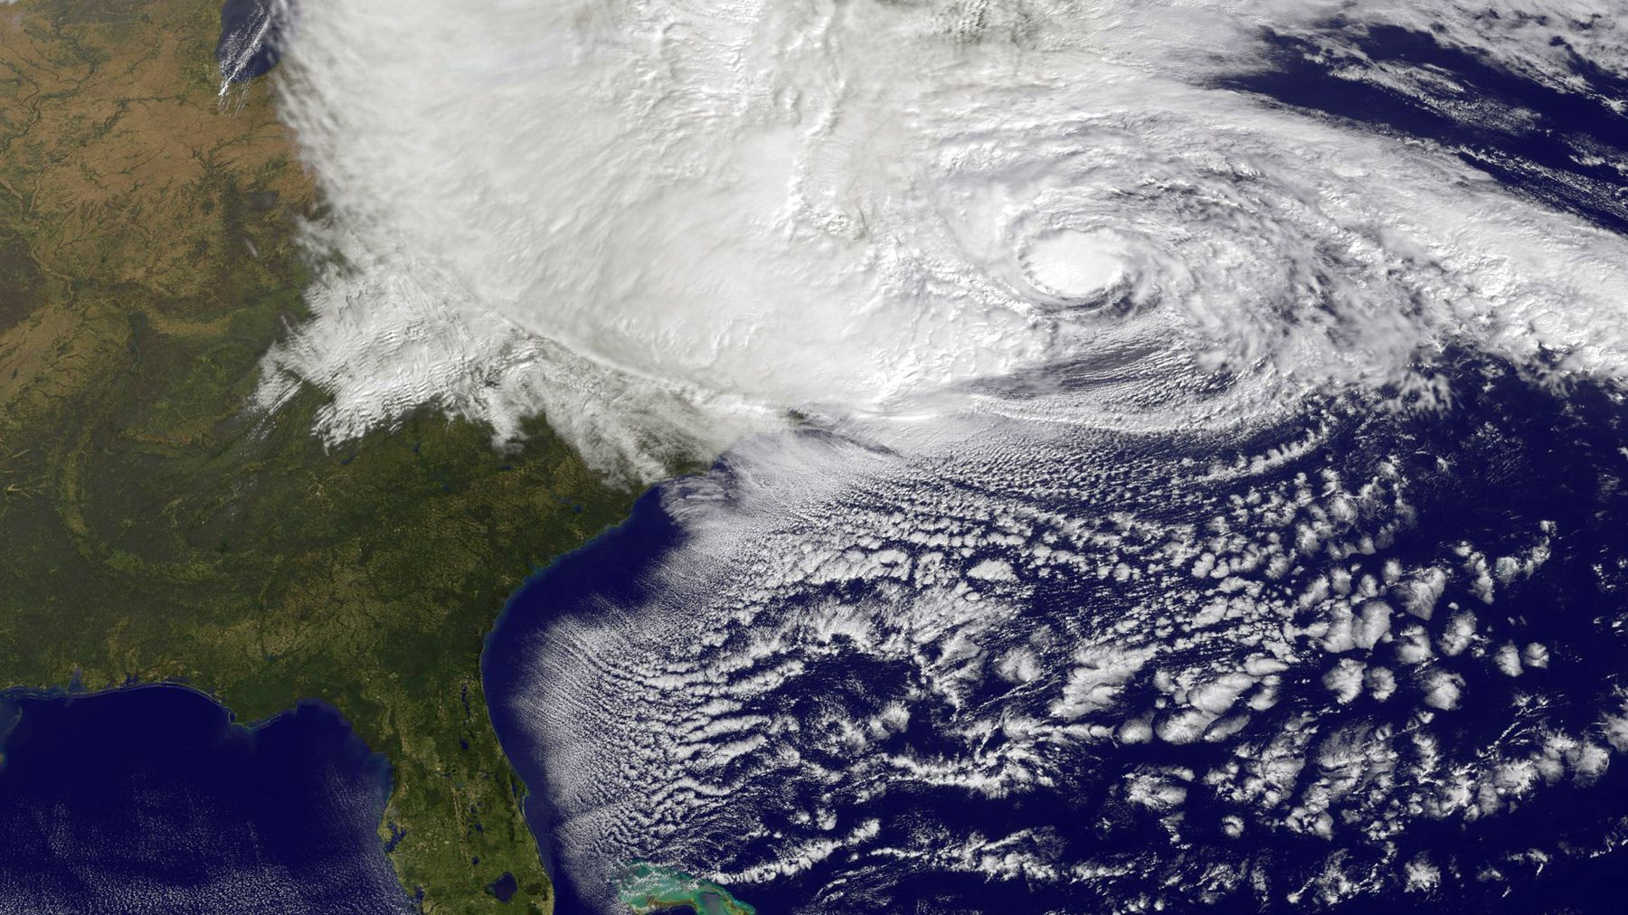
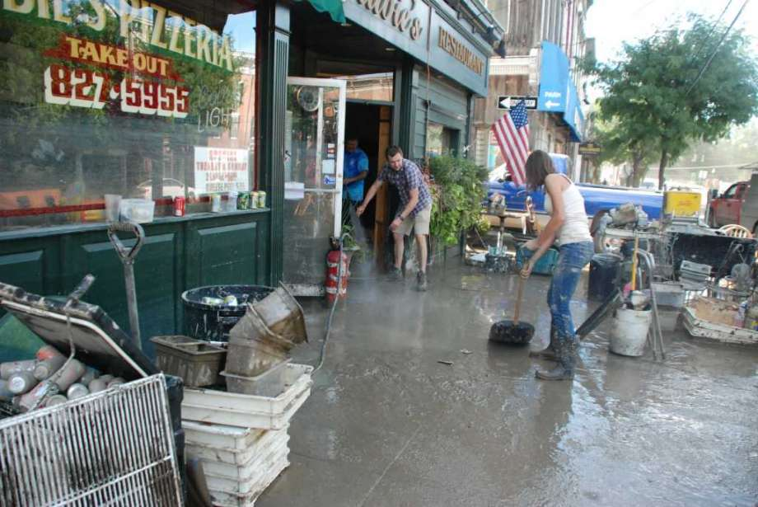
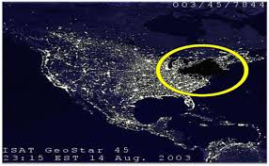

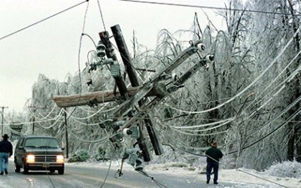

Multi-Agency Recall Audit Checks
Other Applications, Disasters?

Slide 8


Slide 9
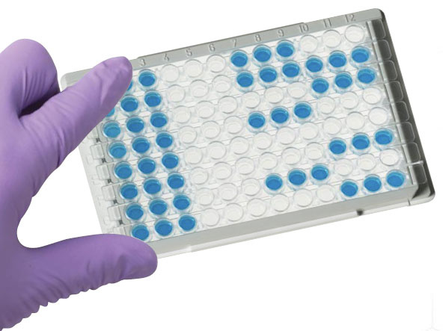
Mycotoxins in Animal Feeds
ELISA – 2-3 days
  One kit for each mycotoxin
  $$
  Expiration dates

Slide 10
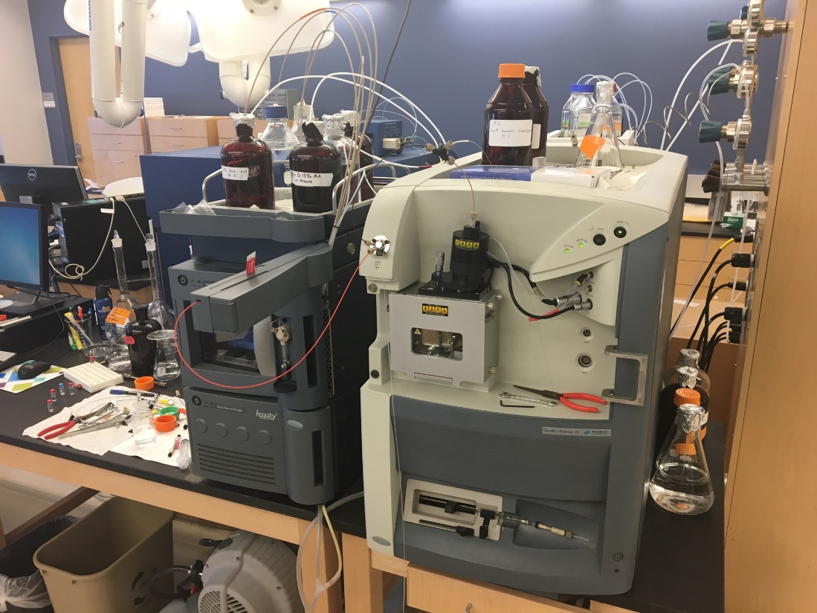
Mycotoxins in Animal Feeds
Ultra Performance Liquid Chromatography (UPLC)
Bob Sheridan, Kristen Gilbert, and Jennifer Mirabile
AAFCO, 8 other state labs
for validation
EU also using a similar method

Slide 11
Mycotoxins in Animal Feeds
2 hours
11 mycotoxins
  Aflatoxin B1, B2, G1, G2, Deoxynivalenol (Vomitoxin), Ochratoxin A, Fumonisin B1, B2, B3, Zearalenone T-2
  Less $$, solvents readily available
  More accurate
Questions? Ask Bob!

Slide 12
Multi-Agency Investigation: Egregious Insanitary Conditions

Slide 13
Participating Agencies
United States Department of Agriculture, Food Safety and Inspection Services (USDA, FSIS)
New York State Department of Agriculture and Markets, Division of Food Safety & Inspection (NYSDAM)
New York State Department of Environmental Conservation, Division of Marine Resources (NYSDEC)
Situational awareness provided by NYSDAM to US Food and Drug Administration (FDA), NY District Office and NYS Department of Health (NYSDOH)

Slide 14
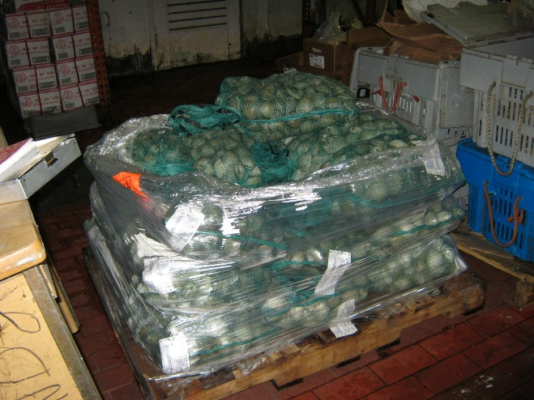
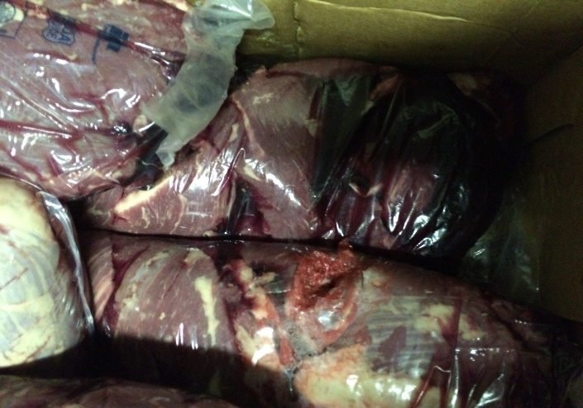
Day 1 – July 21, 2017
USDA, FSIS, OEIA, CID Supervisory Investigator notifies NYSDAM NYC Office of extensive rodent (rat) infestation at 8,000ft² Queens, NY warehouse

Slide 15
7/21/16 - Day 1 Continued
NYSDAM arrives at site and initiates inspection
NYSDAM notifies NYSDEC regarding shellfish
NYSDEC arrives and initiates inspection
NYSDAM places 22,000 lbs of food under state seizure, including meats and shellfish condemned by USDA and NYSDEC

Slide 16
Inspection Findings
NYSDAM inspection findings include:
5 live, and 12 dead rats
Thousands of rat and mouse droppings
10-20 live birds inside warehouse
Numerous flies
Extensive rodent defiled and spilled foods
Extensive damage to floors and walls providing rodent harborage

Slide 17
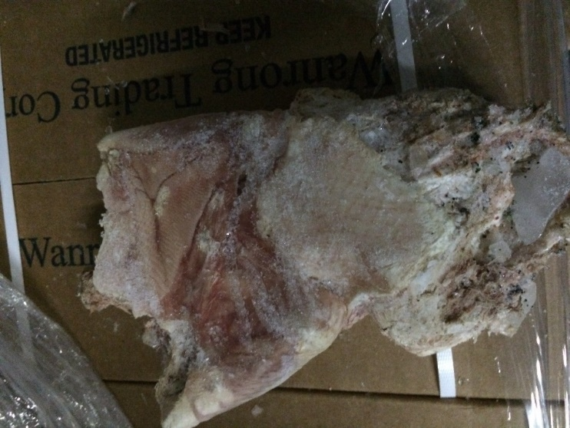
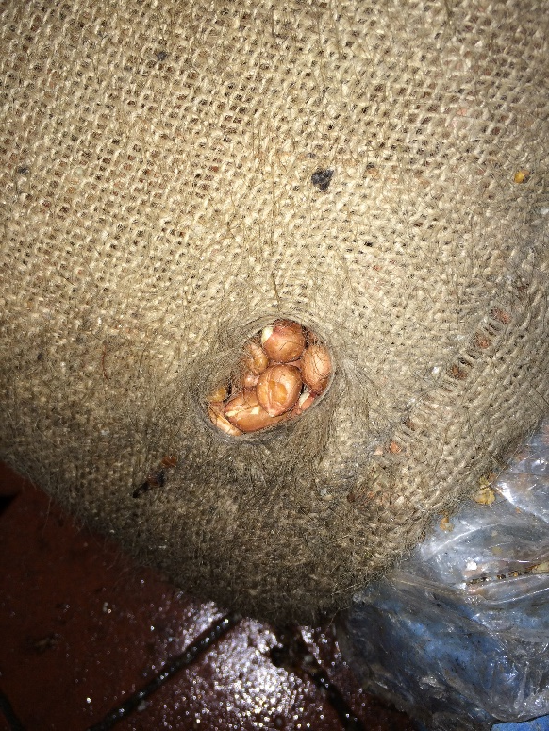
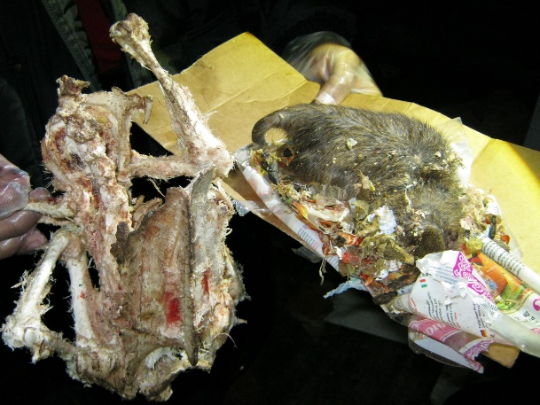
Inspection Findings - Continued
Rodent gnawed Duck

Slide 18
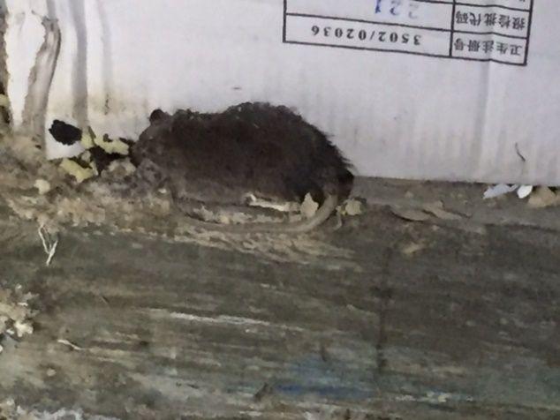
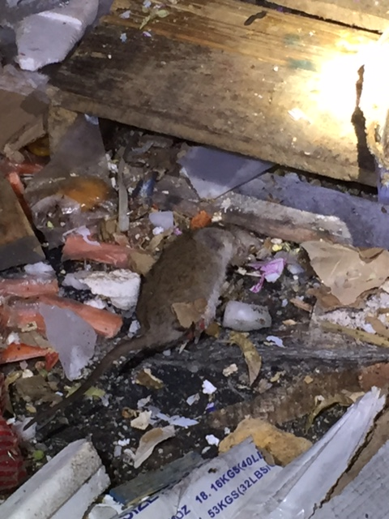
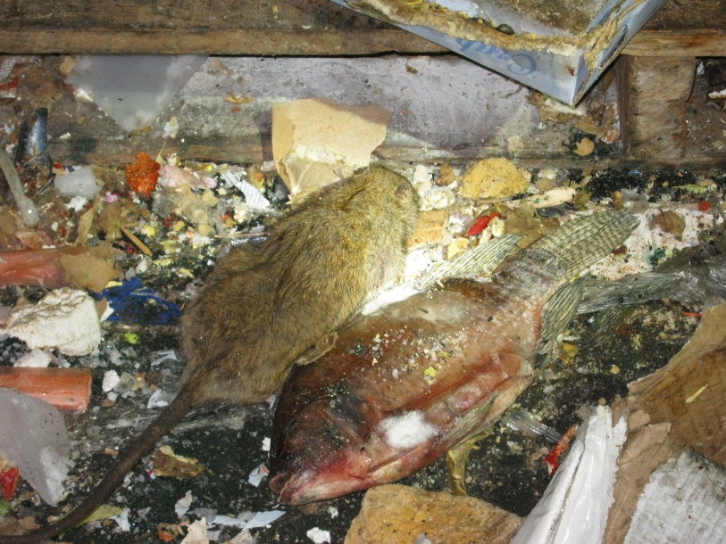
Inspection Findings - Continued

Slide 19
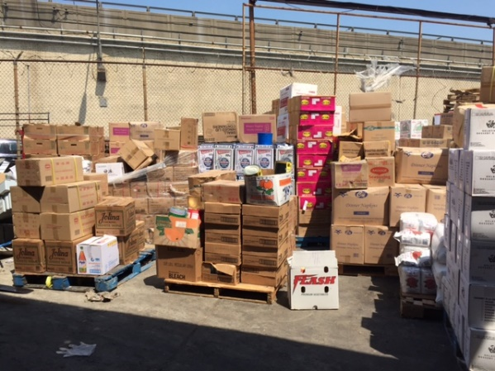
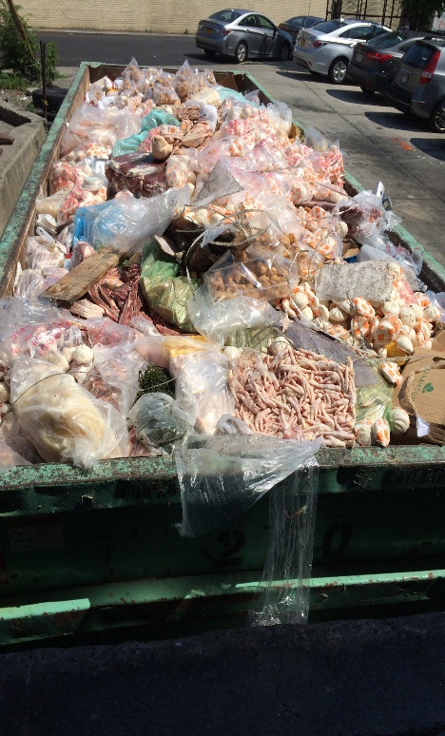
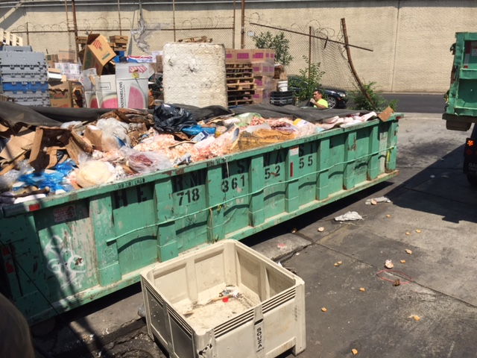
7/22/16 - Product Destruction
Approximately 11 tons of foods destroyed during day 2 of inspection, approximately 16 tons held under NYSDAM open seizure pending disposition

Slide 20
7/22/16 (was a Friday)
Management was instructed by NYSDAM to cease distribution or receipt of food. Any food brought into warehouse subject to state seizure
NYSDAM Office began preparations (evidence gathering) for request for a Temporary Restraining Order to enjoin the establishment from operating as a food warehouse
NYSDEC issued a Shellfish Reshipper Permit Revocation Warning Letter

Slide 21
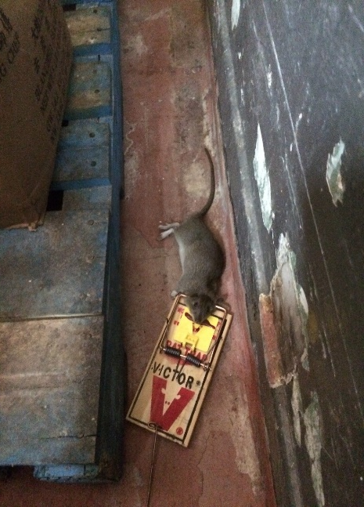
7/25/16 – NYSDAM Investigation
Visit was made by NYSDAM to ensure no activity related to food warehouse operations, the establishment appeared to be in compliance
Verified corrective actions are in process with new exterminator
Confirmed foods under open seizure were intact, and witnessed destruction of 200lbs of rodent defiled foods (already under open seizure)

Slide 22
7/26/16 – NYSDAM TRO
Request for Temporary Restraining Order was delivered to NYDAM Counsel’s Office
Evidence included:
  Inspection report citing several critical deficiencies
  Photo report, including photos taken by NYSDEC and USDA taken during NYSDAM inspectors’ presence
A Civil Penalty of $600 was issued to the establishment
NYSDEC, NYSDOH, USDA and FDA were notified of intent for TRO

Slide 23
7/27/16 – Service of NYSDAM TRO
A TRO was served on the establishment by a NYSDAM Inspector
TRO enjoins the firm from operating as a food warehouse until such time as NYSDAM finds the warehouse in significant compliance with applicable laws and regulation
TRO provides for a appeal to the court on August 5, 2016

Slide 24
7/28/16 – Information Sharing
NYSDAM shared product distribution list and invoices with NYSDOH and FDA. Majority of foods were distributed to restaurants in NYC and surrounding states

Slide 25
7/29/16 - NYSDAM Investigation
NYSDAM visited warehouse to confirm compliance with the TRO
Firm was found to be in compliance with no apparent food operations, and
The open seizure was found intact
Corrective actions were ongoing

Slide 26
8/3/16 – NYSDAM Reinspection
Reinspection was conducted by NYSDAM at the request of the firm
No critical deficiencies were found
No evidence of rodent activity was observed

Slide 27
8/5/16 – Status of TRO
NYSDAM is awaiting the Judge’s Order to vacate the TRO, and would not pursue legal action if the firm resumed operations.
As of this date the firm resumed operations
On 8/8/16 the Judge vacated the Temporary Restraining Order

Slide 28
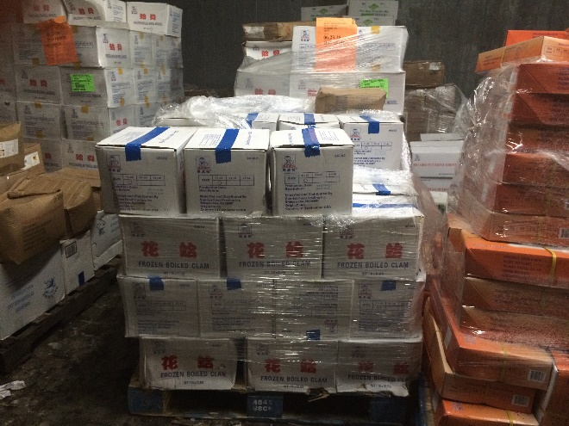
8/15/16 – NYSDAM Investigation
Visit was made by NYSDAM to address foods under open state seizure
900 lbs of food products were destroyed
30,000lbs/15 tons of food products were release from state seizure (Primarily frozen/refrigerated foods)

Slide 29
9/1/16 – Joint Investigation
Visit with NYSDEC and FDA
Confirm corrective actions
NYSDEC conduct unannounced inspection
NYSDEC issues revocation of Shellfish Reshipper Permit on 9/2/16

Slide 30
9/14/16 – Joint Investigation
Visit was made by NYSDAM and USDA
  NYSDAM conducted an inspection
    No evidence of rodents was found, however;
    10-20 birds were present in the warehouse, and were removed during the inspection, this resulted in a critical deficiency requiring follow-up reinspection
NYSDAM conducted a subsequent reinspection on 11/10/16 - no critical deficiencies were noted, no evidence of rodent or bird activity observed

Slide 31
Highlights of
Multi-Agency Investigation
Agency contacts, awareness, and understanding of agency roles
Use of multi-agency compliance tools
Continuous communication between involved agencies
Sharing of investigation findings and situational awareness
Use of multi-agency evidence for applied legal action

Slide 32


